Slide 1
PROGRAMMABLE LOGIC CONTROL
These are solid –state members of computer family using intregrated circuits instead of electomechanical devices to implement control functions.
They can store instructions like sequencing ,timing ,counting ,arithmetic,data manipulation and communication to control industrial machines and processing.
In early 70s were used as relay replacers in controlling industrial automation..its operation include ON/OFF control of the machines and process that required repetitive operation such as transfer lines , grinding and boring machines

Slide 2
ADVANCEMENTS
In advanced programmable controller in industry, changes occur in both hardware(physical components) and software(control program). example of hardware advancement
1.Faster scan time using advanced microprocessor and electronics technology
2.Small ,low cost PLCs
3.High –density I/O system provide space –efficient interfaces at low cost

Slide 3
Example of software advancement
1.PLCs incoperate with OOPs tools and multiple languages based on IE 1131-3 standards
2.Small PLCs have been provided with powerful instructions which extend area of application for small controllers
3.High level languages such as BASIC and C have been implemented
4.Advanced functional block instructions have been implemented for ladder diagram for easy instruction command.

Slide 4
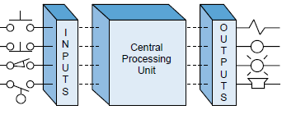
Principle of operation I/O and the CPU

Slide 5
CPU consist of processor, memory system, and the power supply .it govern all PLC activities
I/O system are connected to the field device that encountered the machine and may be discrete or analogy such as limit switch, pressure transducers, push buttons, motor starter ,solenoids
During operation CPU can 1. read or accept data from inputs 2.excutes or performs ,control program stored in the memory system 3.wites or updates the output devices via output interfaces

Slide 6
The whole process of sequentially reading the inputs ,executing the program in the memory and updating the output is known as scanning
Always the programming device or PC are required to enter program into a memory
Assignment : application of plc and its ranges

Slide 7
Ladder diagram
It’s a traditional way of representing electrical sequences of operations.
It represent the interconnection of field devices in such a way that the activation or turning ON, of one device will turn ON another device according to pre determined sequence of events

Slide 8
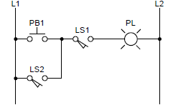
Example of simple

Slide 9
‘’ transformation of previous ladder diagram to PLC format.‘’.
Note the real I/O field devices are connected to input and output interfaces while the ladder program is implemented in a manner similar to hardwiring inside the PLC ‘s CPU (Softwired) Instead of hardwired in a panel
CPU reads the status of inputs ,energizes the corresponding ckt element according to the program and controls a real output device via the output interfaces.

Slide 10
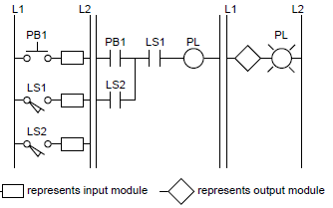
PLC format ladder diagram

Slide 11
Possible solutions
For the hardwired electr.ckt in fig. 1 the pilot light(PL) will turn ON if the limit switch 1(LS1) and push button PB1 or limit switch 2(LS2) closes.
For PLC ckt in fig.2 the same series of events will cause the pilot light connected to output module to turn ON.
The fig.3 shows possible configurations for the ckt in fig.1 ,the highlighted blue lines indicate that power is present to that connection point

Slide 12
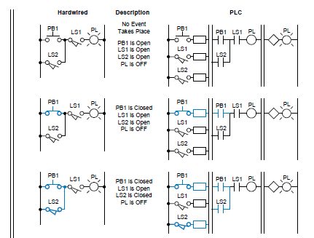
Electric(hardwired) and PLC ckt. Illustration from fig.1&2

Slide 13
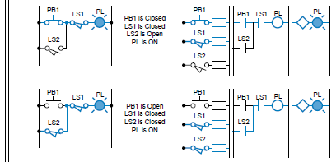
Cont..

Slide 14
Advantages of PLCs
Generally PLC architecture is modular and flexible, allowing hardware and software elements to expand as the application require changes i.e for large application the small unit can be easily replaced with a unit having greater memory and I/O Capacity.
Provides many benefits to control system from reliability and repeatability to programmability

Slide 15
THE MEMORY SYSTEM AND I/O INTERACTION
The memory system is the area in the PLC’s CPU where all of the sequences of instructions, or programs, are stored and executed by the processor to provide the desired control of field devices
The memory sections that contain the control programs can be changed, or reprogrammed to adapt to manufacturing line procedure changes or new system start-up requirements.

Slide 16
The total memory system in a PLC is actually composed of two different memories
the executive memory
the application memory
The executive memory is a collection of permanently stored programs that are considered part of the PLC itself.
These supervisory programs direct all system activities, such as execution of the control program and communication with peripheral devices(i.e., relay instructions, block transfer functions, math instructions, etc.). This area of memory is not accessible to the user.

Slide 17
Cont….
The application memory provides a storage area for the user-programmed instructions that form the application program. The application memory area is composed of several areas, each having a specific function and usage. The storage and retrieval requirements for the executive and application
memory sections are not the same; therefore, they are not always stored in the
same type of memory. For example, the executive requires a memory that
permanently stores its contents and cannot be erased or altered either by loss
of electrical power or by the user. This type of memory is often unsuitable for
the application program.

Slide 18
Memory can be separated into two categories
Volatile memory loses its programmed contents if all operating power is lost or removed, whether it is normal power or some form of backup power
Volatile memory is easily altered and quite suitable for most applications when supported by battery backup and possibly a disk copy of the program.
Nonvolatile memory retains its programmed contents, even during a complete loss of operating power, without requiring a backup source. Nonvolatile memory generally is unalterable, yet there are special nonvolatile memory types that are alterable. Today’s PLCs include those that use nonvolatile memory, those that use volatile memory with battery backup, as well as those that offer both.

Slide 19
Input &Output devices
The input devices include digital and analogue devices such as mechanical switches for position detection, proximity switches, photoelectric switches, encoders, temperature and pressure switches, potentiometers, linear variable differential transformers, strain gauges, thermistors, thermo transistors and thermocouples.
Output devices considered include relays,contactors,solenoid valves and motors.

Slide 20
Input Devices
The term sensor is used for an input device that provides a usable output in response to a specified physical input. For example, a thermocouple is a sensor which converts a temperature difference into an electrical output.
Sensors which give digital/discrete, i.e. on−off, outputs can be easily connected to the input ports of PLCs.
Sensors which give analogue signals have to be converted to digital signals before inputting them to PLC ports.

Slide 21
Examples Of Some Of The Commonly Used PLC Input Devices And Their Sensors.
1. Mechanical switches
A mechanical switch generates an on−off signal or signals as a result of some mechanical input causing the switch to open or close.
Such a switch might be used to indicate the presence of a work piece on a machining table, the work piece pressing against the switch and so closing it.
The absence of the work piece is indicated by the switch being open and its presence by it being closed
Example on the fig (a),shows the input signals to a single input channel of the PLC with its logic levels
work piece not present 0
work piece present 1

Slide 22
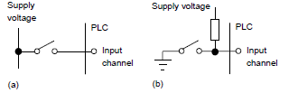
Cont…

Slide 23
From the prev. Slide fig. The 1 level might correspond to a 24 V d.c. input, the 0 to a 0 V input
With the arrangement shown in Figure (b), when the switch is open the supply voltage is applied to the PLC input, when the switch is closed the input voltage drops to a low value. The logic levels are thus:
Work piece not present 1
Work piece present 0
Switches are available with normally open (NO) or normally closed (NC) contacts or can be configured as either by choice of the relevant contacts. An NO switch has its contacts open in the absence of a mechanical input and the mechanical input is used to close the switch.
An NC switch has its contacts closed in the absence of a mechanical input and the mechanical input is used to open the switch.

Slide 24
2.Proximity switches
Proximity switches are used to detect the presence of an item without making contact with it. There are a number of forms of such switches, some being only suitable for metallic objects. The eddy current type of proximity switch has a coil which is energised by a constant alternating current and produces a constant alternating magnetic field. When a metallic object is close to it, eddy currents & voltage are induced in it.
The voltage can be used to activate an electronic switch circuit, basically a transistor which has its output switched from low to high by the voltage change, and so give an on−off device

Slide 25
3.Photoelectric sensors and switches
Photoelectric switch devices can either operate as transmissive types where the object being detected breaks a beam of light, usually infrared radiation, and stops it reaching the detector or reflective types where the object being detected reflects a beam of light onto the detector
In both types the radiation emitter is generally a light-emitting diode (LED). The radiation detector might be a phototransistor, often a pair of transistors, known as a Darlington pair. The Darlington pair increases the sensitivity. Depending on the circuit used, the output can be made to switch to either high or low when light strikes the transistor. Such sensors are supplied as packages for sensing the presence of objects at close range, typically at less than about 5 mm

Slide 26


With the above sensors, light is converted to a current, voltage or resistance change. If the output is to be used as a measure of the intensity of the light, rather than just the presence or absence of some object in the light path, the signal will need amplification and then conversion from analogue to digital by an analogue-to-digital converter.

Slide 27
4. Encoders
The term encoder is used for a device that provides a digital output as a result of angular or linear displacement.
An increment encoder detects changes in angular or linear displacement from some datum position, while an absolute encoder gives the actual angular or linear position.
The Fig . On next slide shows the basic form of an incremental encoder for the measurement of angular displacement. A beam of light, from perhaps a light-emitting diode (LED), passes through slots in a disc and is detected by a light sensor, e.g. a photodiode or phototransistor. When the disc rotates, the light beam is alternately transmitted and stopped and so a pulsed output is produced from the light sensor.

Slide 28
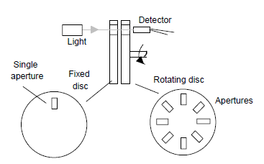

Slide 29
The absolute encoder differs from the incremental encoder in having a pattern of slots which uniquely defines each angular position. With the form shown in Figure on next slide
the rotating disc has four concentric circles of slots and four sensors to detect the light pulses. The slots are arranged in such a way that the sequential output from the sensors is a number in the binary code, each such number corresponding to a particular angular position. With 4 tracks there will be 4 bits and so the number of positions that can be detected is 2^4 = 16, i.e. a resolution of 360/16 = 22.5^o. Typical
encoders tend to have up to 10 or 12 tracks. The number of bits in the
binary number will be equal to the number of tracks. Thus with 10 tracks
there will be 10 bits and so the number of positions that can be detected is 2^10, i.e. 1024, a resolution of 360/1024 = 0.35 ^o.

Slide 30
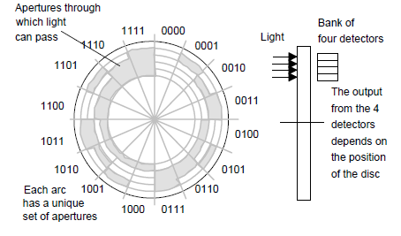

Slide 31
The rotating wheel of the absolute encoder. Note that though the normal form of binary code is shown in the above figure, in practice a modified form of binary code called the Gray code is generally used.
This code, unlike normal binary, has only one bit changing in moving from one number to the next. Thus we have the sequence 0000, 0001, 0011,
0010, 0011, 0111, 0101, 0100, 1100, 1101, 1111.

Slide 32
OUTPUT DEVICES
The input/output channels provide isolation and signal conditioning functions so that sensors and actuators can often be directly connected to them without the need for other circuitry.
It is also through the input/output unit that programs are entered from a program panel. Every input/output point has a unique address which can be used by the CPU.
Electrical isolation from the external world is usually by means of optoisolators (the term optocoupler is also often used).

Slide 33
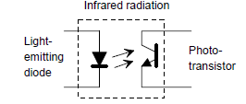
Opto coupler

Slide 34
When a digital pulse passes through the light-emitting diode, a pulse of infrared radiation is produced. This pulse is detected by the phototransistor and gives rise to a voltage in that circuit.
The gap between the light-emitting diode and the phototransistor gives electrical isolation but the arrangement still allows for a digital pulse in one circuit to give rise to a digital pulse in another circuit.
The digital signal that is generally compatible with the microprocessor in the PLC is 5 V d.c. However, signal conditioning in the input channel with isolation, enables a wide range of input signals to be supplied to it .
A range of inputs might be available with a larger PLC, e.g. 5 V, 24 V, 110 V and 240 V digital/discrete,
Outputs are specified as being of relay type, transistor type or triac type

Slide 35
With the relay type, the signal from the PLC output is used to operate a relay and is able to switch currents of the order of a few amperes in an external circuit. The relay not only allows small currents to switch much larger currents but also isolates the PLC from the external circuit. Relays are, however, relatively slow to operate.
Relay outputs are suitable for a.c. and d.c. switching. They can withstand high surge currents and voltage transients.
The transistor type of output uses a transistor to switch current through the external circuit. This gives a considerably faster switching action. It is, however, strictly for d.c. switching and is destroyed by over current and high reverse voltage. As a protection, either a fuse or built-in electronic protection are used. Optoisolators are used to provide isolation
Triac outputs, with optoisolators for isolation, can be used to control external loads which are connected to the a.c. power supply. It is strictly for a.c. operation and is very easily destroyed by overcurrent. Fuses are virtually always included to protect such outputs.

Slide 36
1. Relay
Solenoids form the basis of a number of output control actuators. When a current passes through a solenoid a magnetic field is produced and this can then attract ferrous metal components in its vicinity.
One example of such an actuator is the relay, the term contactor being used when large currents are involved. When the output from the PLC is switched on, the solenoid magnetic field is produced and pulls on the contacts and so closes a switch or switches .
The result is that much larger currents can be switched on. Thus the relay might be used to switch on the current to a motor.

Slide 37
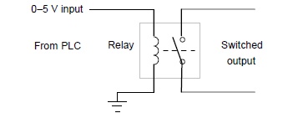

Slide 38
2. Directional control valves
Another example of the use of a solenoid as an actuator is a solenoid operated valve.
The valve may be used to control the directions of flow of pressurised air or oil and so used to operate other devices such as a piston moving in a cylinder.

Slide 39
3.MOTORS
A d.c. motor has coils of wire mounted in slots on a cylinder of ferromagnetic material, this being termed the armature.
The armature is mounted on bearings and is free to rotate. It is mounted in the magnetic field produced by permanent magnets or current passing through coils of wire, these being termed the field coils.
When a current passes through the armature coil, forces act on the coil and result in rotation. Brushes and a commutator are used to reverse the current through the coil every half rotation and so keep the coil rotating.
The speed of rotation can be changed by changing the size of the current to the armature coil.

Slide 40
I/O PROCESSING
The input/output (I/O) unit provides the interface between the PLC controller and the outside world and must therefore provide the necessary signal conditioning to get the signal to the required level and also to isolate it from possible electrical hazards such as high voltages
This chapter includes the forms of typical input/output modules and installation where sensors are some distance from the PLC processing, their communication links to the PLC.

Slide 41
Input signals from sensors and the outputs required for actuating devices can be:
1. Analogue, i.e. a signal whose size is related to the size of the quantity being sensed.
2. Discrete, i.e. essentially just an on−off signal.
3. Digital, i.e. a sequence of pulses
The CPU, however, must have an input of digital signals of a particular size, normally 0 to 5 V. The output from the CPU is digital, normally 0 to 5 V. Thus there is generally a need to manipulate input and output signals so that they are in the required form.

Slide 42
Input units
The terms sourcing and sinking are used to describe the way in which d.c devices are connected to a PLC. With sourcing, using the conventional current flow direction as from positive to negative, an input device receives current from the input module, i.e. the input module is the source of the current.
If the current flows from the output module to an output load then the output module is referred to as sourcing
With sinking, using the conventional current flow direction as from positive to negative, an input device supplies current to the input module, i.e. the input module is the sink for the current
If the current flows to the output module from an output load then the output module is referred to as sinking

Slide 43
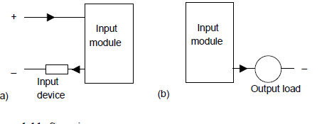
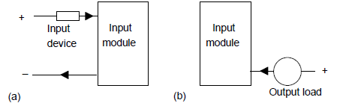
Sourcing and Sinking

Slide 44
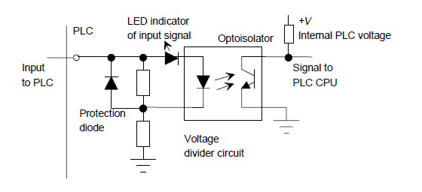
D.C input unit

Slide 45
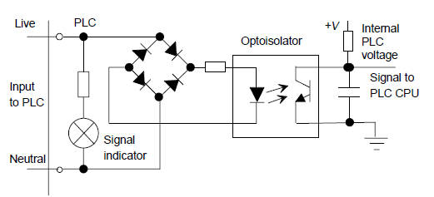
A.C Input Unit

Slide 46
The figures in previous slides show the basic input unit circuits for discrete and digital d.c. and discrete a.c. inputs. Optoisolators are used to provide protection. With the a.c. input unit, a rectifier bridge network is used to rectify the a.c. so that the resulting d.c. signal can provide the signal for use by the optoisolator to give the input signals to the CPU of the PLC.
Individual status lights are provided for each input to indicate when the input device is providing a signal.
Analogue signals can be inputted to a PLC if the input channel is able to convert the signal to a digital signal using an analogue-to-digital converter. With a rack mounted system this may be achieved by mounting a suitable analogue input card in the rack.

Slide 47
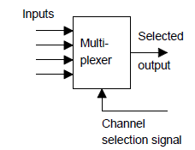
So that one analogue card is not required for each analogue input, multiplexing is generally used see the figure below

Slide 48
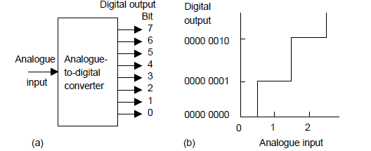

Slide 49
Fig (a) in previous slide illustrates the function of an analogue-to-digital converter (ADC). A single analogue input signal gives rise to on−off output signals along perhaps eight separate wires. The eight signals then constitute the so-termed digital word corresponding to the analogue input signal level.
With such an 8-bit converter there are 2^8 = 256 different digital values possible; these are 0000 0000 to 1111 1111, i.e. 0 to 255.
The digital output goes up in steps Fig(b) and the analogue voltages required to produce each digital output are termed quantisation levels

Slide 50
The analogue voltage has to change by the difference in analogue voltage between successive levels if the binary output is to change. The term resolution is used for the smallest change in analogue voltage which will give rise to a change in one bit in the digital output. With an 8-bit ADC if, say, the full-scale analogue input signal varies between 0 and 10 V then a step of one digital bit involves an analogue input change of 10/255 V or about 0.04 V.
This means that a change of 0.03 V in the input will produce no change in the digital output. The number of bits in the output from an analogue-to-digital converter thus determines the resolution, and hence accuracy, possible. If a 10-bit ADC is used then 210 = 1024 different digital values are possible and, for the full-scale analogue input of 0 to 10 V, a step of one digital bit involves an analogue input change of 10/1023 V or about 0.01 V.
In general, the resolution of an n-bit ADC is 1/(2^n – 1).

Slide 51
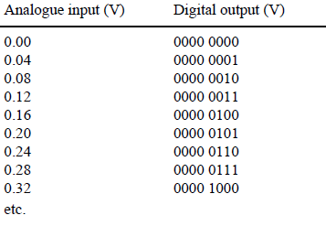
Analogue-to-digital conversion for an 8-bit converter when the analogue input is in the range 0 to 10 V:

Slide 52
Output units
With a PLC output unit, when it provides the current for the output device.fig a below said to be sourcing and when the output device provides the current to the output unit it is said to be sinking.
Fig. b Quite often, sinking input units are used for interfacing with electronic equipment and sourcing output units for interfacing with solenoids.

Slide 53
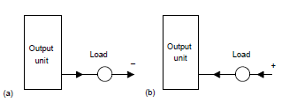
Output units: (a)sourcing (b) sinking

Slide 54
Output units can be relay, transistor or triac. Figures below shows the basic form of a relay output unit, transistor output unit and that of a triac output unit.

Slide 55
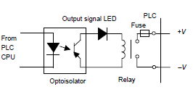
Relay output module

Slide 56
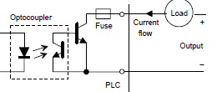
Transistor o/p unit current sinking

Slide 57
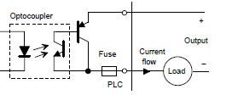
Transistor o/p unit current sourcing

Slide 58
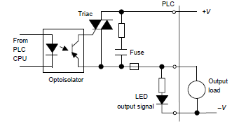
Triac output unit

Slide 59
Analogue outputs are frequently required and can be provided by digital-to-analogue converters (DACs) at the output channel.
The input to the converter is a sequence of bits with each bit along a parallel line as shown on next slide.

Slide 60
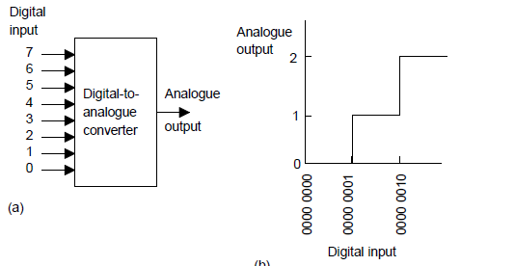

Slide 61
A bit in the 0 line gives rise to a certain size output pulse. A bit in the 1 line gives rise to an output pulse of twice the size of the 0 line pulse. A bit in the 2 line gives rise to an output pulse of twice the size of the 1 line pulse. A bit in the 3 line gives rise to an output pulse of twice the size of the 2 line pulse, and so on.
When the digital input changes, the analogue output changes in a stepped manner, the voltage changing by the voltage changes associated with each bit. For example, if we have an 8-bit converter then the output is made up of voltage values of 2^8 = 256 analogue steps. Suppose the output range is set to 10 V d.c. One bit then gives a change of 10/255 V or about 0.04 V.

Slide 62
Signal Conditioning
When connecting sensors which generate digital or discrete signals to an input unit, care has to be taken to ensure that voltage levels match.
However, many sensors generate analogue signals. In order to avoid having a multiplicity of analogue input channels to cope with the wide diversity of analogue signals that can be generated by sensors, external signal conditioning is often used to bring analogue signals to a common range and so allow a standard form of analogue input channel to be used.

Slide 63
A common standard that is used (Fig. below) is to convert analogue signals to a current in the range 4 to 20 mA and thus to a voltage by passing it through a 250 Ώ resistance to give a 1 to 5 V input signal.
Thus, for example, a sensor used to monitor liquid level in the height range 0 to 1 m would have the 0 level represented by 4 mA and the 1 m represented by 20 mA.

Slide 64
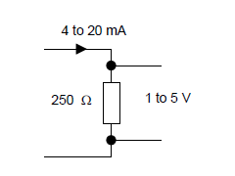

Slide 65
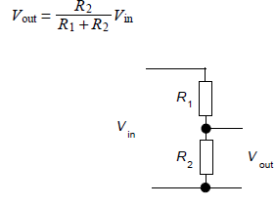
A potential divider (Figure below) can be used to reduce a voltage from a sensor to the required level; the output voltage level Vout is:

Slide 66


Amplifiers can be used to increase the voltage level; Figure shows the basic form of the circuits that might be used with a 741 operational amplifier with (a) being an inverting amplifier and (b) a non-inverting
amplifier. With the inverting amplifier the output Vout is:

Slide 67
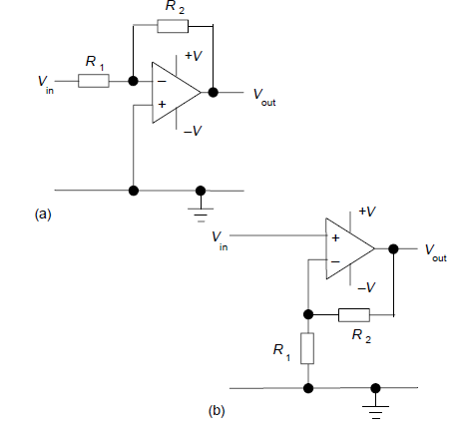

Slide 68

Often a differential amplifier is needed to amplify the difference between two input voltages. Such is the case when a sensor, e.g. a strain gauge, is connected in a Wheatstone bridge and the output is the difference between two voltages or a thermocouple where the voltage difference between the hot and cold junctions is required.
Figure shows the basic form of an operational amplifier circuit for this purpose. The output voltage Vout is:

Slide 69
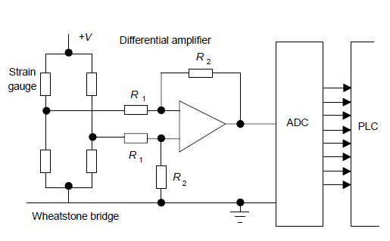

Slide 70
As an illustration of the use of signal conditioning, Figure on previous slide shows the arrangement that might be used for a strain gauge sensor.
The sensor is connected in a Wheatstone bridge and the out-of-balance potential difference amplified by a differential amplifier before being fed via an analogue-to-digital converter unit which is part of the analogue input port of the PLC.

Slide 71
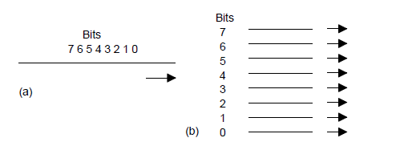
Serial and Parallel Communications

Slide 72
Serial communication is when data is transmitted one bit at a time (Figure (a)). Thus if an 8-bit word is to be transmitted, the eight bits are transmitted one at a time in sequence along a cable. This means that a data word has to be separated into its constituent bits for transmission and then reassembled into the word when received.
Parallel communication is when all the constituent bits of a word are simultaneously transmitted along parallel cables (Figure (b)). This allows data to be transmitted over short distances at high speeds.

Slide 73
Serial communication is used for transmitting data over long distances. It is much cheaper to run, for serial communication, a single core cable over a long distance than the multicore cables that would be needed for parallel communication
Parallel communication might be used when connecting laboratory instruments to the system. However, internally, PLCs work, for speed, with parallel communications. Thus, circuits called UARTS (universal asynchronous receivers–transmitters) have to be used at input/output ports to converts serial communications signals to parallel.

Slide 74
Serial standards
Requirements for serial communication
Determine the voltage levels to be used for signals, i.e. what signal represents a 0 and what represents a 1.
2. What the bit patterns being transmitted mean and how the message is built up. A sequence of words are being sent along the same cable and it is necessary to determine when one word starts and finishes and the next word starts.
3. The speed at which the bit pattern is to be sent, i.e. the number of bits per second.
Synchronization of the clocks at each end.

Slide 75
5. Protocols, or flow controls, to enable such information as ‘able to receive data’ or ‘not ready to receive data’. This is commonly done by using two extra signal wires (termed handshake wires), one to tell the receiver that the transmitter is ready to send the data and the other to tell the transmitter that the receiver is ready to receive data.
6. Error-checking to enable a bit pattern to be checked to determine if corruption of the data has occurred during transmission

Slide 76
The most common standard serial communications interface used is the RS232. Connections are made via 25-pin D-type connectors (see the figure on next slide).
With usually, though not always, a male plug on cables and a female socket on the equipment. Not all the pins are used in every application.

Slide 77
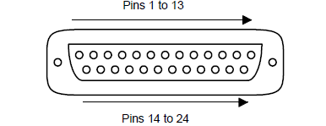
D TYPE CONNECTOR

Slide 78
The minimum requirements are:
Pin 1: Ground connection to the frame of chassis
Pin 2: Serial transmitted data (output data pin)
Pin 3: Serial received data (input data pin)
Pin 7: Signal ground which acts as a common signal return path
A configuration that is widely used with interfaces involving computers is:
Pin 1: Ground connection to the frame of chassis
Pin 2: Serial transmitted data (output data pin)
Pin 3: Serial received data (input data pin)
Pin 4: Request to send
Pin 5: Clear to send
Pin 6: Data set ready
Pin 7: Signal ground which acts as a common signal return path
Pin 20: Data terminal ready

Slide 79
The signals sent through pins 4, 5, 6 and 20 are used to check that the receiving end is ready to receive a signal, the transmitting end is ready to send and the data is ready to be sent. With RS232, a 1 bit is represented by a voltage between −5 and −25 V, normally −12 V, and a 0 by a voltage between +5 and +25 V, normally +12 V.

Slide 80
The term baud rate is used to describe the transmission rate, it being approximately the number of bits transmitted or received per second.
However, not all the bits transmitted can be used for data, some have to be used to indicate the start and stop of a serial piece of data, these often being termed flags, and as a check as to whether the data has been corrupted during transmission

Slide 81
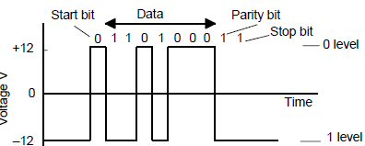
RS232 signal levels
The fig. below shows the type of signal that might be sent with RS232. The parity bit is added to check whether corruption has occurred, with even parity a 1 being added to make the number of 1s an even number. To send seven bits of data, eleven bits may be required.

Slide 82
The signals sent through pins 4, 5, 6 and 20 are used to check that the
receiving end is ready to receive a signal, the transmitting end is ready to
send and the data is ready to be sent. With RS232, a 1 bit is represented
by a voltage between −5 and −25 V, normally −12 V, and a 0 by a voltage
between +5 and +25 V, normally +12 V.

Slide 83
Ladder and functional block programming
Programming can be made even easier by the use of the so-called high level languages, e.g. C, BASIC, PASCAL, FORTRAN,COBOL
These use pre-packaged functions, represented by simple words or symbols descriptive of the function concerned. For example, with C language the symbol & is used for the logic AND operation. However, the use of these methods to write programs requires some skill in programming and PLCs are intended to be used by engineers without any great knowledge of programming, hence ladder diagram programming was developed.
This is a means of writing programs which can then be converted into machine code by some software for use by the PLC microprocessor.

Slide 84
This chapter is an introduction to the programming of a PLC using ladder diagrams and functional block diagrams, Here we are concerned with the basic techniques involved in developing ladder and function block programs to represent basic switching operations, involving the logic functions of AND, OR, Exclusive OR, NAND and NOR, and latching.

Slide 85
PLC ladder programming
Writing a program is then equivalent to drawing a switching circuit. The ladder diagram consists of two vertical lines representing the power rails. Circuits are connected as horizontal lines, i.e. the rungs of the ladder, between these two verticals.
a). The vertical lines of the diagram represent the power rails between which circuits are connected. The power flow is taken to be from the left-hand vertical across a rung.
b). Each rung on the ladder defines one operation in the control process.
c). A ladder diagram is read from left to right and from top to bottom. See on the next fig.

Slide 86
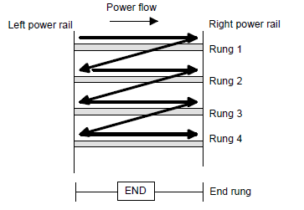
.
Note:The end rung might be indicated by a block with the word END or RET for return, since the program promptly returns to its beginning

Slide 87
d). Each rung must start with an input or inputs and must end with at least one output.
e). Electrical devices are shown in their normal condition. Thus a switch which is normally open until some object closes it, is shown as open on the ladder diagram. A switch that is normally closed is shown closed.
f). A particular device can appear in more than one rung of a ladder. For example, we might have a relay which switches on one or more devices. The same letters and/or numbers are used to label the device in each situation.

Slide 88
g). The inputs and outputs are all identified by their addresses, the notation used depending on the PLC manufacturer.
Note: Some slight variations occur between the symbols when used in semi-graphic form and when in full graphic. Note that inputs are represented by different symbols representing normally open or normally closed contacts

Slide 89
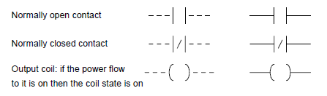
Some symbol in semi and full graphics

Slide 90
In drawing ladder diagrams the names of the associated variable or addresses of each element are appended to its symbol. Thus Figures below shows how the ladder diagram would appear using
(a) Mitsubishi, (b) Siemens, (c) Allen-Bradley, (d) Telemecanique notations for the addresses. Thus Figure (a) indicates that this rung of the ladder program has an input from address X400 and an output to address Y430.
When wiring up the inputs and outputs to the PLC, the relevant ones must be connected to the input and output terminals with these addresses.

Slide 91
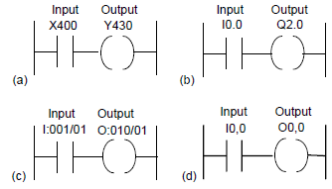

Slide 92
Logic functions
There are many control situations requiring actions to be initiated when a certain combination of conditions is realised.
Consider the drill motor is to be activated when the limit switches are activated that indicate the presence of the workpiece and the drill position as being at the surface of the workpiece ,Such a situation involves the AND logic function, condition A and condition B having both to be realised for an output to occur.

Slide 93
AND
Shows a situation where an output is not energised unless two, normally open, switches are both closed. Switch A and switch B have both to be closed, which thus gives an AND logic situation. We can think of this as representing a control system with two inputs A and B

Slide 94
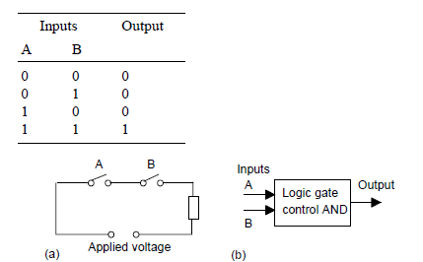
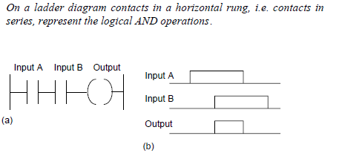

Slide 95
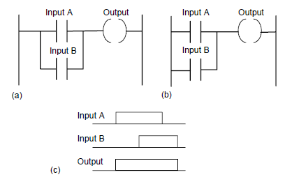
OR
Shows an electrical circuit where an output is energised when switch A or B, both normally open, are closed. The lader diagram describe it

Slide 96
An example of an OR gate control system is a conveyor belt transporting bottled products to packaging where a deflector plate is activated to deflect bottles into a reject bin if either the weight is not within certain tolerances or there is no cap on the bottle

Slide 97
TIMERS, COUNTERS
Timers and counters have been in existence for as long as relays and provide an important component in the development of logic.
Timers were constructed in the past as an add-on device to relays slowing down the transition of the plunger from immediately opening or closing. The time delay was accomplished with a pneumatic bladder that allowed the air to escape either quickly or slowly depending on the setting of the timer.
Quick was usually less than a second and slow was usually between 30 and 60 seconds. Setting this kind of timer was an inexact science and today's traffic lights are an example of the fickle nature of timers that seldom respond in exactly the same from day to day and year to year.

Slide 98
Timers
Timers are used to provide logic when a circuit turns on or off. Traditional pneumatic timers were provided as either on-delay timers or off-delay timers.
Contacts were provided both normally open and normally closed for each type of timer. The timer head was chosen as either the on-delay type or off-delay type.
PLCs allow for a quick change from one type to the other with a few keystrokes on the programming panel.

Slide 99
PLC vendors do not need to use the terms of on-delay or off-delay, normally closed, normally open, held closed, or held open, these terms are an important part of design of PLC circuits.
Some vendors still use the terms to show linkage between the PLC and the original timer circuits.
Allen-Bradley provides three timers; TON, TOF, and RTO. All are block-type instructions and are located at the extreme right of each rung used.

Slide 100
TON: Generate on-delay
TP: Generate pulse
The instruction Generate pulse sets output Q for duration PT. The instruction is started when the result of logic operation (RLO) at input IN changes from 0 to 1 (positive signal edge). The programmed time PT begins when the instruction starts. Output Q is set for the duration PT, regardless of the subsequent course of the input signal. Even if a new positive signal edge is detected, the signal state at the output Q is not affected as long as the PT time is running.

Slide 101
The instruction Generate on-delay delays setting of the output Q by the programmed duration PT. The instruction is started when the result of logic operation (RLO) at input IN changes from 0 to 1 (positive signal edge).
The programmed time PT begins when the instruction starts. When the duration PT expires, the output Q has the signal state 1. Output Q remains set as long as the start input is still 1.
When the signal state at the start input changes from 1 to 0, output Q is reset. The timer function is started again when a new positive signal edge is detected at the start input.

Slide 102
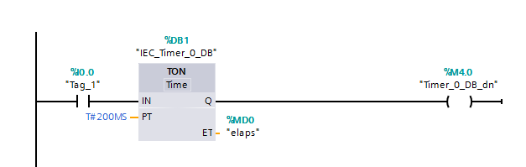

Slide 103
TOF: Generate off-delay
The instruction Generate off-delay delays resetting of the output Q by the programmed duration PT. The Q output is set when the result of logic operation (RLO) at input IN changes from 0 to 1 (positive signal edge).
When the signal state at input IN returns back to 0, programmed time (PT) starts. Output Q remains set as long as the duration PT is running.
When duration PT expires, the Q output is reset. If the signal state at the IN input changes to 1 before the duration PT expires, the time is reset. The signal state at the output Q will continue to be 1.

Slide 104
The current time value can be queried at the ET output. The time value starts at T#0s and ends when the value of duration PT is reached.
When the duration PT expires, the ET output remains set to the current value until input IN changes back to 1. If input IN switches to 1 before the duration PT has expired, the ET output is reset to the value T#0s

Slide 105
---( TON )---: Start on-delay timer
The Start on-delay timer instruction starts an IEC timer with a specified duration as on-delay timer.
The IEC timer is started when the result of logic operation (RLO) changes from 0 to 1 (positive signal edge). The IEC timer runs for the specified time. A query of the timer status for 1 returns signal state 1 if the time has expired and the RLO at the input of the instruction is 1.
If the RLO changes to 0 before the time expires, the IEC timer is reset. In this case, querying the timer status for 1 returns signal state 0. The IEC timer restarts when the next positive signal edge is detected at the input of the instruction

Slide 106
( TOF )---: Start off-delay timer
The Start off-delay timer instruction starts an IEC timer with a specified duration as off-delay timer. The query of the timer status for 1 returns the signal state 1 if the result of the logic operation (RLO) at the input of the instruction has the signal state 1.
When the RLO changes from 1 to 0 (negative signal edge), the IEC timer starts with the specified time. The timer status remains at signal state 1 as long as the IEC timer is running.
When the timer has run out and the RLO at the input of the instruction has the signal state 0, the timer status is set to the signal state 0. If the RLO changes to 1 before the time expires, the IEC timer is reset and the timer status remains at signal state 1.

Slide 107
---( TONR )---: Time accumulator
The Time accumulator instruction records how long the signal is at the input of instruction 1. The instruction is started when the result of logic operation (RLO) changes from 0 to 1 (positive signal edge).
The time is recorded as long at the RLO is 1. If the RLO changes to 0, the instruction is halted. If the RLO changes back to 1, the time recording is continued.
The query of the timer status for 1 returns the signal state 1 if the recorded time exceeds the value of the specified duration and the RLO at the input of coil is 1. The timer status and the currently expired timer can be reset to 0 using the Reset timer instruction.

Slide 108
---( RT )---: Reset timer
The Reset timer instruction resets an IEC timer to 0. The instruction is only executed if the result of logic operation (RLO) at the input of the coil is 1.
If current is flowing to the coil (RLO is 1), the structure components of the timer in the specified data block are reset to 0. If the RLO at the input of the instruction is 0, the timer remains unchanged.
The instruction does not influence the RLO. The RLO at the input of the coil is sent directly to the output of the coil. You assign the Reset timer instruction an IEC timer that has been declared in the program

Slide 109
CTD: Count down
You can use the Count_down instruction to decrement the value at output CV. When the signal state at the CD input changes from 0 to 1 (positive signal edge), the instruction executes and the current count value at the CV output is decremented by one.
When the instruction executes the first time, the count value of the CV parameter is set to the value of the PV parameter. Each time a positive signal edge is detected, the count value is decremented until it reaches the low limit value of the specified data type.
When the low limit is reached, the signal state at the CD input no longer has an effect on the instruction.

Slide 110
You can scan the counter status at the Q output. If the current count value is less than or equal to zero, the Q output is set to signal state 1.
In all other cases, the Q output has signal state 0. You can also specify a constant for the PV parameter. The value at the CV output is set to the value of the PV parameter when the signal state at the LD input changes to 1.
As long as the LD input has signal state 1, the signal state at the CD input has no effect on the instruction.

Slide 111
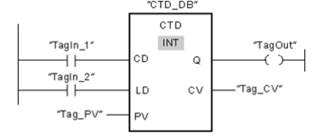
The following example shows how the instruction works:

Slide 112

LogixPro allows you to practice and develop your RSLogix programming skills where and when you want.
It replaces the PLC, ladder rung editor, and all the electrical components that have until now, been required to learn RSLogix.

Slide 113
When the signal state of the TagIn_1 operand changes from 0 to 1, the Count down instruction executes and the value at the Tag_CV output is decremented by one.
With each additional positive edge signal, the count value is decremented until the low limit of the specified data type (-32,768) is reached.
The TagOut output has signal state 1 as long as the current count value is less than or equal to zero. In all other cases, the TagOut output has signal state 0.

Slide 114
Getting Started with RSLogix & LogixPro
LogixPro allows you to practice and develop your RSLogix programming skills where and when you want.
It replaces the PLC, ladder rung editor, and all the electrical components that have until now, been required to learn RSLogix

Slide 115
The LogixPro Screen
The most commonly used elements of LogixPro are displayed below. The Edit Panel provides easy access to all the RSLogix instructions and they may be simply dragged and dropped into your program.
Once your program is ready for testing, clicking on the "Toggle Button" of the Edit Panel will bring the PLC Panel into view. From the PLC Panel you can download your program to the "PLC" and then place it into the "RUN" mode. This will initiate the scanning of your program and the I/O of your chosen simulation.

Slide 116
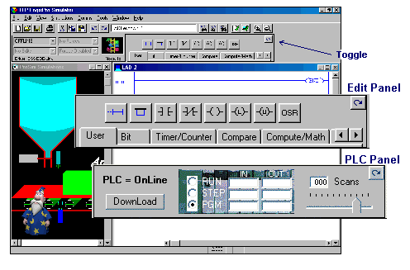

Slide 117
Editing Your Program
Both Instructions and Rungs are selected simply by clicking on them with the left mouse button.
Deleting is then just a matter of hitting the Del key on your keyboard.
Double Clicking (2 quick clicks) with the left mouse button allows you to edit an instruction's address while right clicking (right mouse button) displays a pop-up menu of related editing commands.
Click on an Instruction or Rung with the left mouse button and keep it held down and you will be able to drag it wherever you please.

Slide 118

Debugging Your Program
If you take a look at the PLC Panel you'll notice an adjustable Speed Control. This is not a component of normal PLCs, but is provided with LogixPro so that you may adjust the speed of the simulations to suit your particular computer.
When the simulation is slowed, so is the PLC scanning. You can use this to good effect when trying to debug your program. Set the scan slow enough and you can easily monitor how your program's instructions are responding. This capability may not be typical of real PLCs, but for Training Purposes, you will find that it is an invaluable debugging tool

Slide 119

Relay Logic Introductory Lab
RSLogix Relay Logic Instructions This exercise is designed to familiarize you with the operation of LogixPro and to step you through the process of creating, editing and testing simple PLC programs utilizing the Relay Logic Instructions supported by RSLogix.
From the Simulations Menu at the top of the screen, Select the I/O Simulation and ensure that the User Instruction Bar shown above is visible.

Slide 120
The program editing window should contain a single rung. This is the End of Program rung and is always the last rung in any program. If this is the only rung visible then your program is currently empty.
If your program is not empty, then click on the File menu entry at the top of the screen and select "New" from the drop-down list. A dialog box will appear asking for you to select a Processor Type. Just click on "OK" to accept the default TLP LogixPro selection.

Slide 121

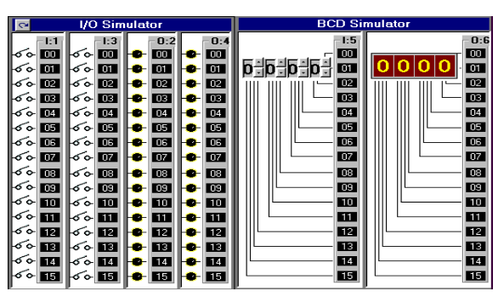
Now maximize the ProSim-II Simulation Window

Slide 122
. The I/O Simulator
The simulator screen shown on last slide, should now be in view. For this exercise we will be using the I/O simulator section, which consists of 32 switches and lights.
Two groups of 16 toggle switches are shown connected to 2 Input cards of our simulated PLC. Likewise two groups of 16 Lights are connected to two output cards of our PLC. The two input cards are addressed as "I:1" and "I:3" while the output cards are addressed "O:2" and "O:4".

Slide 123
Use your mouse to click on the various switches and note the change in the status color of the terminal that the switch is connected to.
Move your mouse slowly over a switch, and the mouse cursor should change to a hand symbol, indicating that the state of switch can be altered by clicking at this location.
When you pass the mouse over a switch, a "tool-tip" text box also appears and informs you to "Right Click to Toggle Switch Type". Click your right mouse button on a switch, and note how the switch type may be readily changed

Slide 124
RSLogix Program Creation
I want you to now enter the following single run program which consists of a single Input instruction (XIC - Examine If Closed) and a single Output instruction (OTE - Output Energize).
There's more than one way to accomplish this task

Slide 125


First click on the "New Rung" button in the User Instruction Bar. It's the first button on the very left end of the Bar.
If you hold the mouse pointer over any of these buttons for a second or two, you should see a short "ToolTip" which describes the function or name of the instruction that the button represents.

Slide 126
You should now see a new Rung added to your program as shown on last slide, and the Rung number at the left side of the new rung should be highlighted. Note that the new Rung was inserted above the existing (END) End Of Program Rung.
Alternatively you could have dragged (left mouse button held down) the Rung button into the program window and dropped it onto one of the locating boxes that would have appeared.

Slide 127
Now click on the XIC instruction with your left mouse button (Left Click) and it will be added to the right of your highlighted selection. Note that the new XIC instruction is now selected (highlighted).
Once again, you could have alternatively dragged and dropped the instruction into the program window.

Slide 128
If you accidentally add an instruction which you wish to remove, just Left Click on the instruction to select it, and then press the "Del" key on your keyboard. Alternatively, you may right click on the instruction and then select "Cut" from the drop-down menu that appears.

Slide 129


Left Click on the OTE output instruction and it will be. added to the right of your current selection
Double Click (2 quick left mousebutton clicks) on the XIC instruction and a textbox should appear which will allow you to enter the address (I:1/0) of the switch we wish to monitor. Use the Backspace key to get rid of the "?" currently in the textbox. Once you type in the address, click anywhere else on the instruction (other than the textbox) and the box should close.
Right Click on the XIC instruction and select "Edit Symbol" from the drop-down menu that appears. Another textbox will appear where you can type in a name (Switch-0) to associate with this address. As before, a click anywhere else will close the box.

Slide 130

Enter the address and symbol for the OTE instruction and your first RSLogix program will now be complete. Before continuing however, Double check that the addresses of your instructions are correct.

Slide 131

Testing your Program
It's now time to "Download" your program to the PLC. First click on the "Toggle" button at the top right corner of the Edit Panel which will bring the PLC Panel into view.

Slide 132
Click on the "DownLoad" button to initiate the downloading of your program to the PLC. Once complete, click inside the "RUN" option selection circle to start the PLC scanning.
Enlarge the Simulation window so that you can see both the Switches and Lamps, by dragging the bar that separates the Simulation and Program windows to the right with your mouse. Now click on Switch I:1/00 in the simulator and if all is well, Lamp O:2/00 should illuminate.

Slide 133
Toggle the Switch On and Off a number of times and note the change in value indicated in the PLC Panel's status boxes which are being updated constantly as the PLC Scans. Try placing the PLC back into the "PGM" mode and then toggle the simulator's Switch a few times and note the result. Place the PLC back into the "Run" mode and the Scan should resume.
We are usually told to think of the XIC instruction as an electrical contact that allows electrical flow to pass when an external switch is closed. We are then told that the OTE will energize if the flow is allowed to get through to it. In actual fact the XIC is a conditional instruction which tests any bit that we address for Truth or a 1.

Slide 134
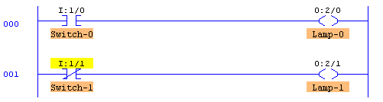
Editing your Program
Click on the "Toggle" button of the PLC Panel which will put the PLC into the PGM mode and bring the Edit Panel back into view.
Now add a second rung to your program as shown below. This time instead of entering the addresses as you did before, try dragging the appropriate address which is displayed in the I/O simulation and dropping it onto the instruction.

Slide 135
Note that the XIO instruction which Tests for Zero or False has it's address highlighted in yellow. This indicates that the instruction is True, which in the case of an XIO, means that the bit addressed is currently a Zero or False

Slide 136
Once you feel comfortable with dragNdrop, ensure that your program once again looks like the one pictured above, Now download your program to the PLC and place the PLC into the Run Mode.
Toggle both Switch-0 and Switch-1 on and off a number of times and observe the effects this has on the lamps. Ensure that you are satisfied with the operation of your program before proceeding further

